Slide 1
Integrated Tourism Web Appilication
PIP2001 Capstone Project
Viva voice
Batch Number: CIT G-23
Roll Number | Student Name
20211CIT0005 | J Jaswanth Kumar
20211CIT0006 | A Gopi Chandu
20211CIT0007 | Lekkala Vardhan
20211CIT0048 | B Ashok Kumar Reddy
20211CIT0174 | A Punith
Under the Supervision of
Ms . Amreen Khanum D
Assistant Professor
School of Computer Science and Engineering
Name of the Program: B.TECH
Name of the HoD: Dr S P Anandaraj
Name of the Program Project Coordinator: Dr. Sharmasth Vali Y
Name of the School Project Coordinators: Dr. Sampath A K / Dr. Abdul Khadar A / Mr. Md Ziaur Rahman

Slide 2
Introduction
Urban travel presents unique challenges for visitors, including navigating unfamiliar cities, finding suitable accommodations, booking transportation, and discovering local events.
Existing travel apps often address these needs individually, requiring users to switch between multiple platforms.
This fragmentation can be time-consuming and frustrating for travelers.
A review of existing travel apps reveals that while many offer individual functionalities, few have successfully integrated accommodation, transportation, and event booking into a single platform.

Slide 3
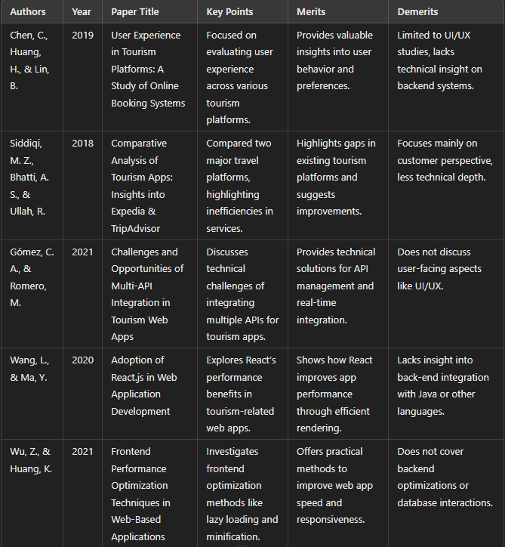
Literature Review

Slide 4
Research gaps identified
Area | Gap Identified | Impact
Service Integration | Fragmented platforms for different travel needs | Inefficient and time-consuming user experience
Personalization | Lack of tailored recommendations | Reduced user satisfaction and engagement
Real-Time Data | Delayed or unreliable updates | Poor decision-making and reduced trust
Scalability | Limited regional and operational scalability | Inaccessibility for global users
User Interface Design | Complex and non-intuitive interfaces | Challenges for less tech-savvy users
Security and Privacy | Inadequate measures for protecting user data | Loss of user trust and potential legal consequences
Holistic User Experience | Absence of comprehensive travel planning | Incomplete solutions that fail to meet user expectations

Slide 5
Proposed Method
Key Features of the Proposed System
Integrated Services: A single platform for booking hotels, cabs, and events.
Role-Based Access: Distinct login portals for administrators, staff, and users, each with specific privileges.
Real-Time Data Updates: Ensuring accurate and up-to-date information on service availability and bookings.
User-Friendly Interface: An intuitive design that caters to users with varying levels of technical expertise.
Secure Transactions: A robust payment gateway (Razorpay) for safe and seamless financial transactions.
Personalized Recommendations: Leveraging user data to provide tailored suggestions for hotels, events, and transportation.

Slide 6
Objectives
The objectives of the Overall Tourism Booking System are designed to guide the development process and ensure that the final product meets the needs of users while addressing existing gaps in the tourism booking landscape.
The following objectives outline the key goals of the project:
1.Secure User Authentication
Objective : Implement a robust user authentication system to protect user data and ensure secure access.
Goal : Provide features such as sign-up, sign-in, password recovery, and secure session management to build user trust.
2. Comprehensive Booking Options
Objective : Offer a wide range of booking services, including destinations, hotels, transportation, and events.
Goal : Allow users to plan and book all aspects of their travel in one place, enhancing convenience and efficiency.
3. Personalized Recommendations
Objective : Utilize user data and preferences to provide personalized destination and service recommendations.
Goal : Enhance user engagement and satisfaction by suggesting relevant options based on individual travel history and interests.

Slide 7
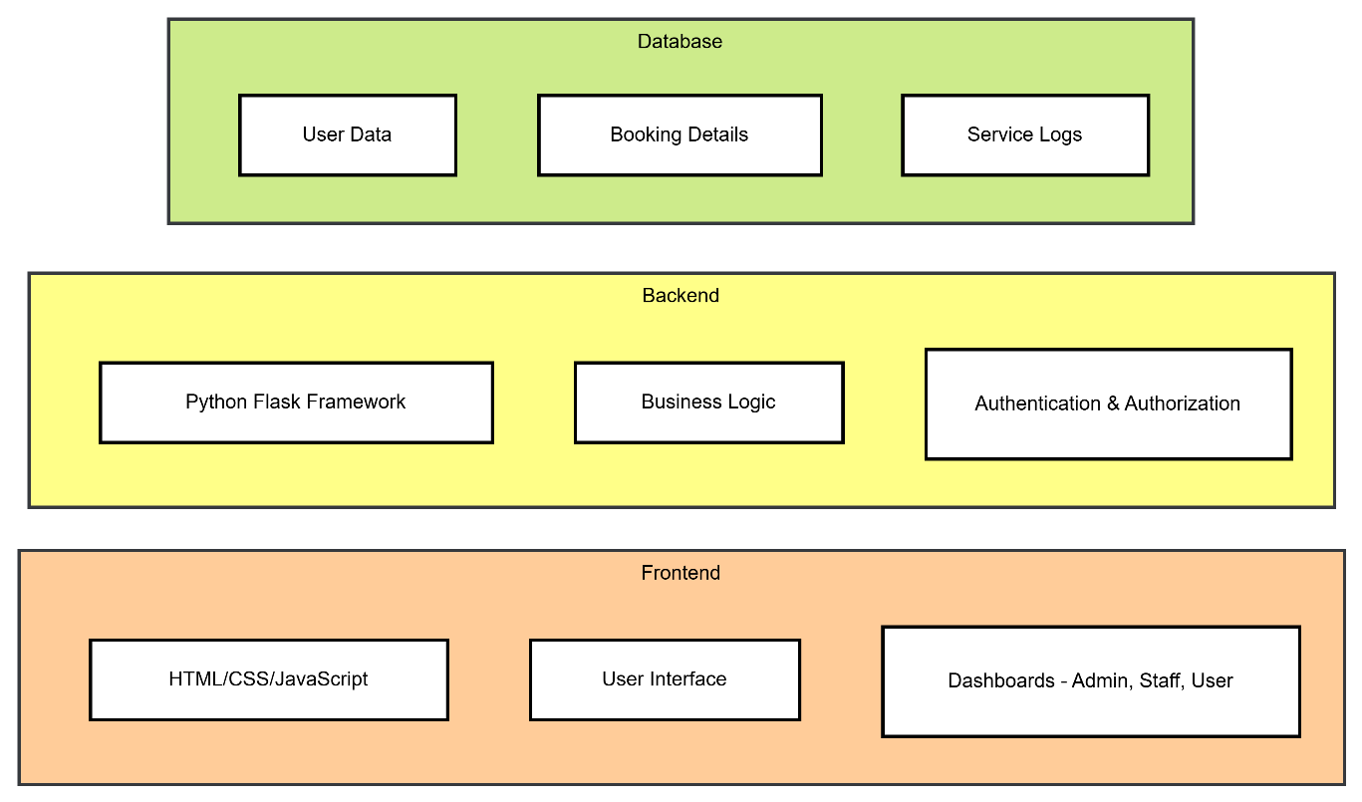
System Design And Implementation

Slide 8
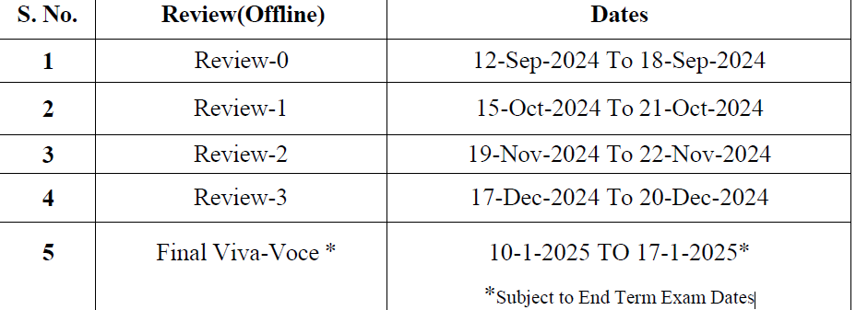
Timeline of Project

Slide 9
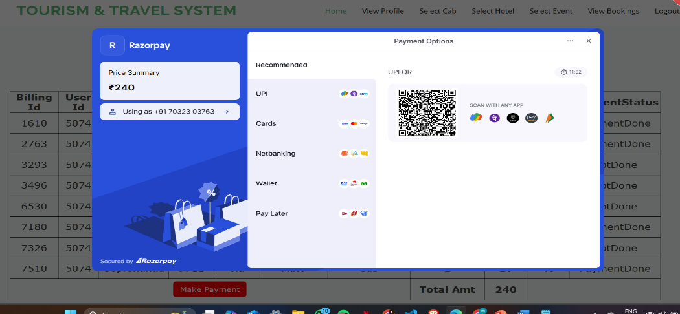
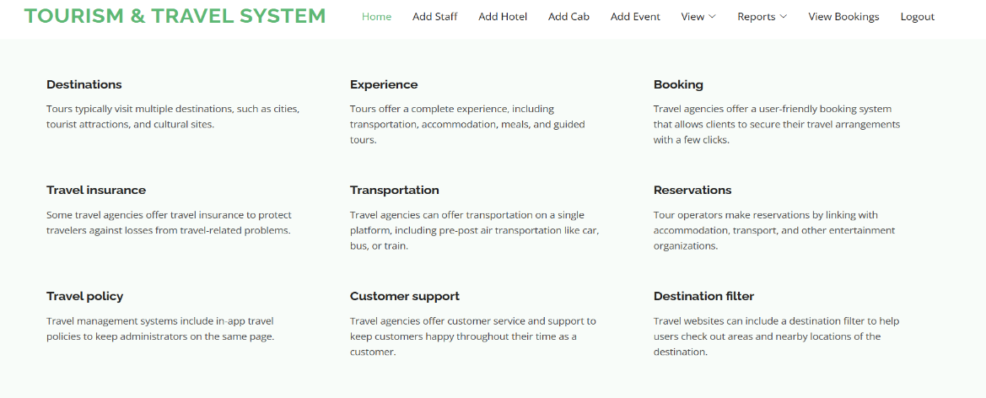
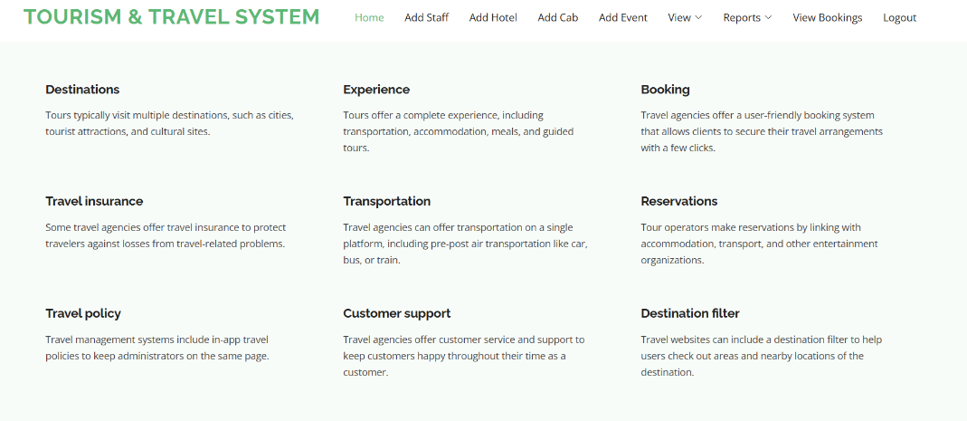
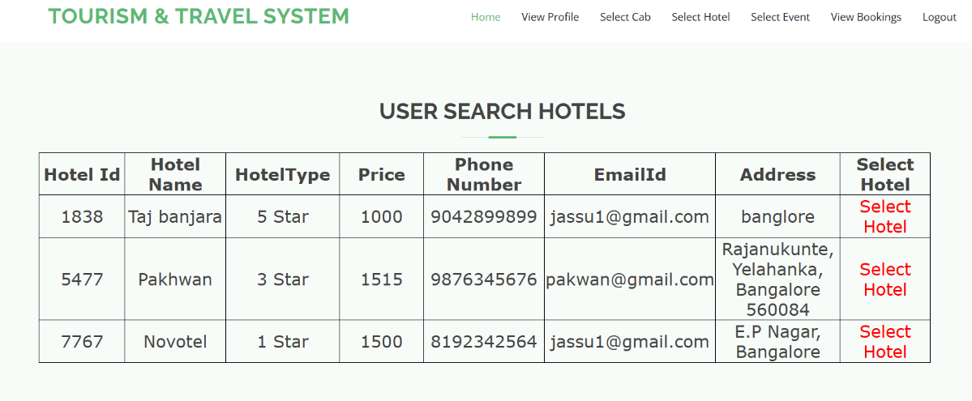
Outcomes

Slide 10
Conclusion
The development and deployment of the tourism service platform has been a significant achievement, fulfilling its primary objective of integrating multiple travel-related services into a single, user-friendly application. The platform successfully addresses a common problem faced by travelers: the need to navigate through several different apps or websites to book hotels, cabs, and events. By consolidating these services, the platform not only saves users time but also enhances their overall travel experience. The ease of use, combined with the efficiency of having all services in one place, has proven to be highly beneficial, as evidenced by the positive feedback from users.
In conclusion, the tourism service platform has proven to be a successful and valuable tool for both users and service providers. It has not only simplified the travel planning process but also delivered significant operational benefits to businesses in the tourism industry. With continued development and the addition of new features, the platform has the potential to become a leading solution in the travel and tourism sector, providing users with a one-stop shop for all their travel needs.

Slide 11
References
Smith, J. (2020). Tourism and Travel in the Digital Age: Trends and Insights. Journal of Tourism Technology, 15(3), 45-59.
Johnson, A. & Williams, L. (2019). Smart Tourism: Leveraging Technology for Seamless Travel Experiences.
Singh, R., Gupta, M., & Sharma, S. (2021). A Comprehensive Review of Mobile Applications in the Tourism Industry. Journal of Hospitality and Tourism Management, 18(2), 134-142.
Miller, P. (2020). Integration of Travel Services: A Study of Multi-Service Platforms in the Tourism Sector. Journal of Business and Economics, 29(1), 72-85.
Kumar, R. & Patel, S. (2022). Mobile Apps for Tourism: The Rise of One-Stop Solutions. International Journal of Mobile Technology, 11(1), 56-68.
Bennett, T. & Clark, D. (2020). The Role of Cloud Computing in the Evolution of Tourism Applications. Journal of Cloud Computing and Tourism, 12(3), 29-41.
Firebase Documentation (2023). Firebase Realtime Database Overview.
Flask Documentation (2023). Flask Web Development: A Guide to Building Python Web Applications.
Razorpay Documentation (2023). Razorpay Payment Gateway Integration Guide.
Tourism Industry Report (2021). Trends in Online Travel Booking: A Global Perspective. World Tourism Organization, 5(2), 58-72.

Slide 12
Publication Details

Slide 13
Thank You

